Slide 1
Credit EDA Case Study
Performed by :
Praveen Niranjan Sharma

Slide 2
Introduction
This case study aims to give you an idea of applying EDA in a real business scenario. In this case study, apart from applying the techniques that you have learnt in the EDA module, you will also develop a basic understanding of risk analytics in banking and financial services and understand how data is used to minimize the risk of losing money while lending to customers.
Business Understanding
The loan providing companies find it hard to give loans to the people due to their insufficient or non-existent credit history. Because of that, some consumers use it as their advantage by becoming a defaulter. Suppose you work for a consumer finance company which specializes in lending various types of loans to urban customers. You have to use EDA to analyse the patterns present in the data. This will ensure that the applicants capable of repaying the loan are not rejected.
When the company receives a loan application, the company has to decide for loan approval based on the applicant’s profile.
Two types of risks are associated with the bank’s decision:
If the applicant is likely to repay the loan, then not approving the loan results in a loss of business to the company.
If the applicant is not likely to repay the loan, i.e. he/she is likely to default, then approving the loan may lead to a financial loss for the company.

Slide 3
The data given below contains the information about the loan application at the time of applying for the loan. It contains two types of scenarios:
The client with payment difficulties: he/she had late payment more than X days on at least one of the first Y instalments of the loan in our sample,
All other cases: All other cases when the payment is paid on time.
When a client applies for a loan, there are four types of decisions that could be taken by the client/company):
Approved: The Company has approved loan Application
Cancelled: The client cancelled the application sometime during approval. Either the client changed her/his mind about the loan or in some cases due to a higher risk of the client he received worse pricing which he did not want.
Refused: The company had rejected the loan (because the client does not meet their requirements etc.).
Unused offer: Loan has been cancelled by the client but on different stages of the process.
In this case study, you will use EDA to understand how consumer attributes and loan attributes influence the tendency of default.
Business Objectives
This case study aims to identify patterns which indicate if a client has difficulty paying their installments which may be used for taking actions such as denying the loan, reducing the amount of loan, lending (to risky applicants) at a higher interest rate, etc. This will ensure that the consumers capable of repaying the loan are not rejected. Identification of such applicants using EDA is the aim of this case study.
In other words, the company wants to understand the driving factors (or driver variables) behind loan default, i.e. the variables which are strong indicators of default. The company can utilise this knowledge for its portfolio and risk assessment.

Slide 4
To develop your understanding of the domain, you are advised to independently research a little about risk analytics - understanding the types of variables and their significance should be enough).
Data Understanding
This dataset has 3 files as explained below:
'application_data.csv' contains all the information of the client at the time of application. The data is about whether a client has payment difficulties.
'previous_application.csv' contains information about the client’s previous loan data. It contains the data whether the previous application had been Approved, Cancelled, Refused or Unused offer.
'columns_description.csv' is data dictionary which describes the meaning of the variables.
Results Expected by Learners
Present the overall approach of the analysis in a presentation. Mention the problem statement and the analysis approach briefly.
Identify the missing data and use appropriate method to deal with it. (Remove columns/or replace it with an appropriate value)
Hint: Note that in EDA, since it is not necessary to replace the missing value, but if you have to replace the missing value, what should be the approach. Clearly mention the approach.
Identify if there are outliers in the dataset. Also, mention why do you think it is an outlier. Again, remember that for this exercise, it is not necessary to remove any data points.
Identify if there is data imbalance in the data. Find the ratio of data imbalance.

Slide 5
Hint: How will you analyse the data in case of data imbalance? You can plot more than one type of plot to analyse the different aspects due to data imbalance. For example, you can choose your own scale for the graphs, i.e. one can plot in terms of percentage or absolute value. Do this analysis for the ‘Target variable’ in the dataset ( clients with payment difficulties and all other cases). Use a mix of univariate and bivariate analysis etc.
Hint: Since there are a lot of columns, you can run your analysis in loops for the appropriate columns and find the insights.
Explain the results of univariate, segmented univariate, bivariate analysis, etc. in business terms.
Find the top 10 correlation for the Client with payment difficulties and all other cases (Target variable). Note that you have to find the top correlation by segmenting the data frame w.r.t to the target variable and then find the top correlation for each of the segmented data and find if any insight is there. Say, there are 5+1(target) variables in a dataset: Var1, Var2, Var3, Var4, Var5, Target. And if you have to find top 3 correlation, it can be: Var1 & Var2, Var2 & Var3, Var1 & Var3. Target variable will not feature in this correlation as it is a categorical variable and not a continuous variable which is increasing or decreasing.
Include visualizations and summaries the most important results in the presentation. You are free to choose the graphs which explain the numerical/categorical variables. Insights should explain why the variable is important for differentiating the clients with payment difficulties with all other cases.
You need to submit one/two I python notebook which clearly explains the thought process behind your analysis (either in comments of markdown text), code and relevant plots. The presentation file needs to be in PDF format and should contain the points discussed above with the necessary visualizations. Also, all the visualizations and plots must be done in Python(should be present in the I python notebook), though they may be recreated in Tableau for better aesthetics in the PPT file.

Slide 6
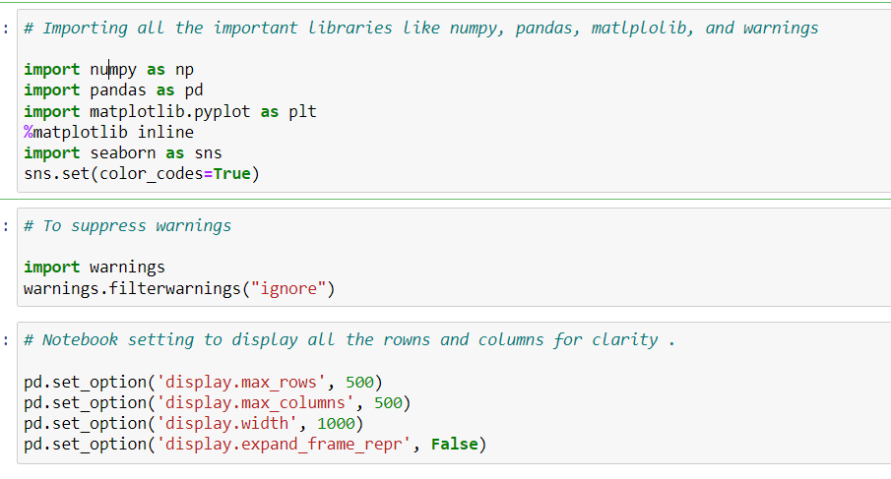
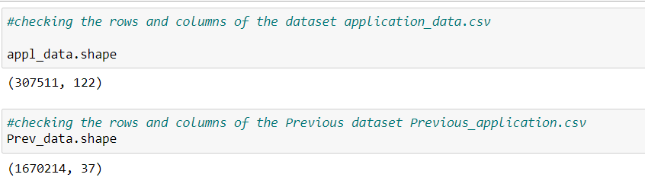
IMPORTING ALL REQUIRED MODULES
Understanding the dataset :
There are 122 columns having various data types like object, int, float and 307511 rows in application_data.
There are 37 columns having various data types like object, int, float and 1670214 rows in Previous_application.
Days columns having negative values where fixing is needed.

Slide 7
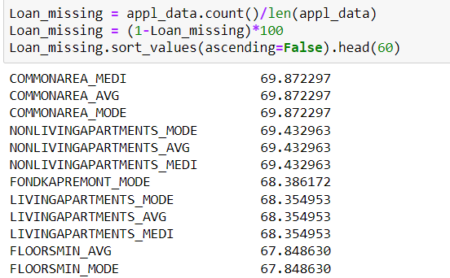
2. Data Cleaning & Manipulation on application_data
2.1. Finding Null Values in dataset
Insights:
There are 41 columns with missing value more than 50 %.
These columns can not be considered for analysis .
Dropping all columns having null value > 50%.

Slide 8
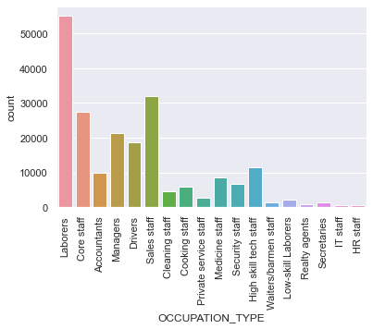
Missing value treatment
As we can observe that there are around 41 columns having missing values more than 50 % . so , We will not consider these columns for our analysis. There are other columns with missing values 13 % to 49%.so, We will consider other columns for analysis.
As we can observe that this column has 31% of missing values. Since it is a categorical column, we can only replace it with mode value. But, replacing all of these 31% missing values with "Laborers" class will make dataset biased. So, we will leave it as it is and will not do any missing value treatment here.

Slide 9
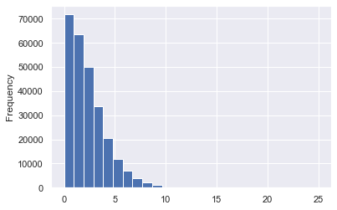
AMT_REQ_CREDIT_BUREAU_YEAR
Insight :
As we observe that the values are only integers so we will replace by mode value and not mean value because median value will give an decimal value.

Slide 10
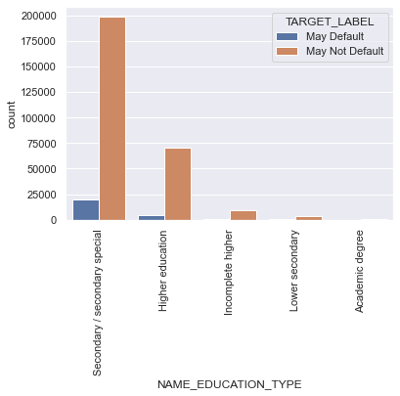
Analysing categorical data
Due to data imbalance, we will separate out the Loan data frame with a target equal to 0 and target equal to 1. And we will analyse them individually and try to find any relationship if it exists.

Slide 11
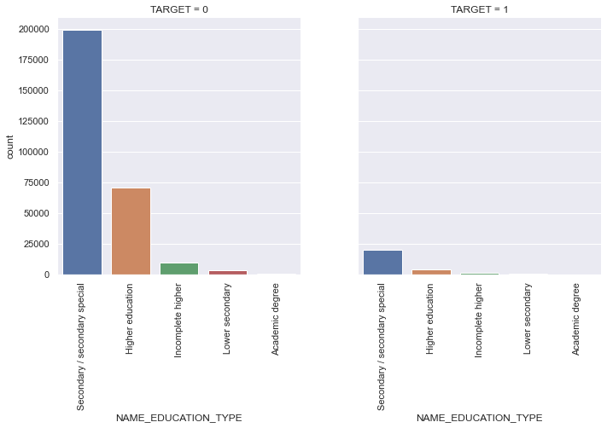
INSIGHTS FROM ABOVE 3 GRAPHS on 'NAME_EDUCATION_TYPE’ :
Loan Application from Customer with Secondary education have higher chance that they will not default followed by higher education. here we can infer that Academic degree has less defaults.

Slide 12
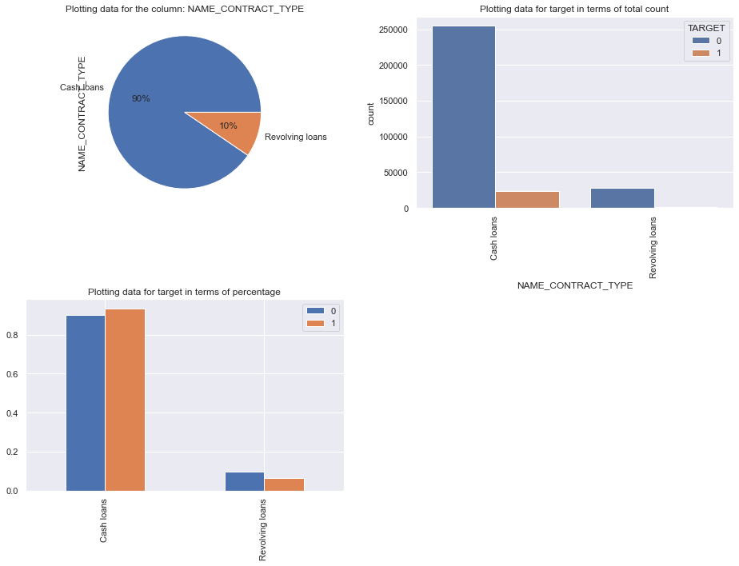
Univariate Analysis of Categorical columns
NAME_CONTRACT_TYPE: Customer with payment difficulty prefer cash loans higher than customer without payment difficulty. Customer without payment difficulty prefer revolving loans also .Revolving loans are just a small fraction from the total number of loans.

Slide 13
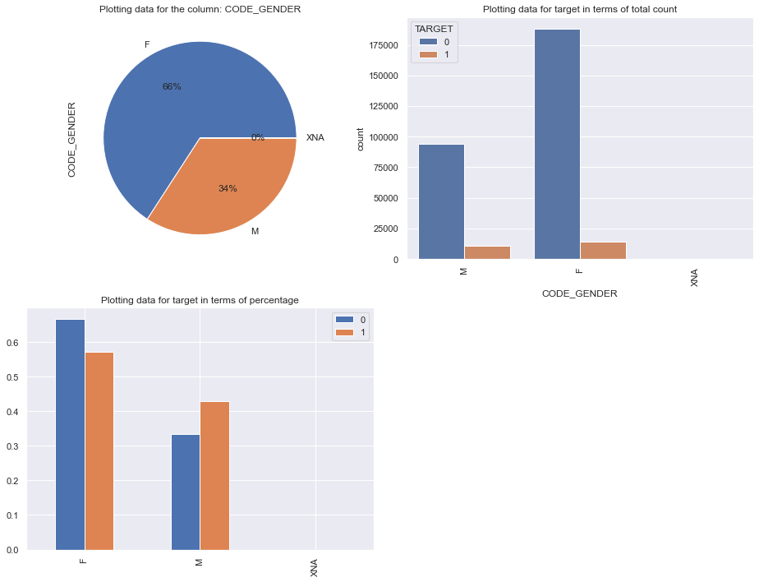
CODE_GENDER: Less number of males take loan but the defaulters are higher in case of males. Therefore males have a higher chance of not returning their loans.

Slide 14
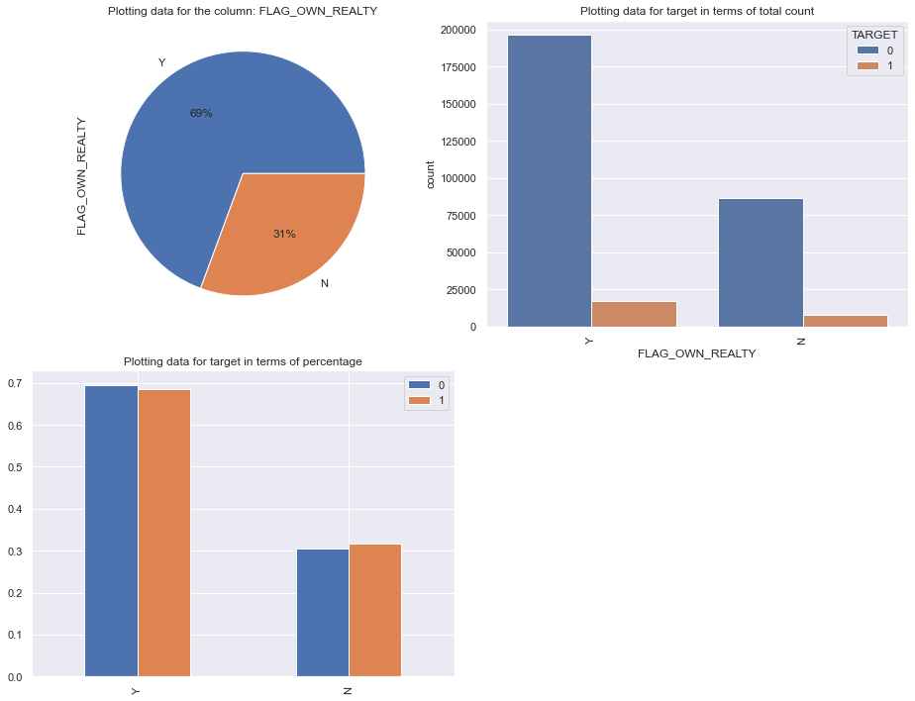
FLAG_OWN_REALTY: The defaulting rate of both categories are approx. same. Thus we can infer that there is no correlation between owning a reality and defaulting the loan.

Slide 15
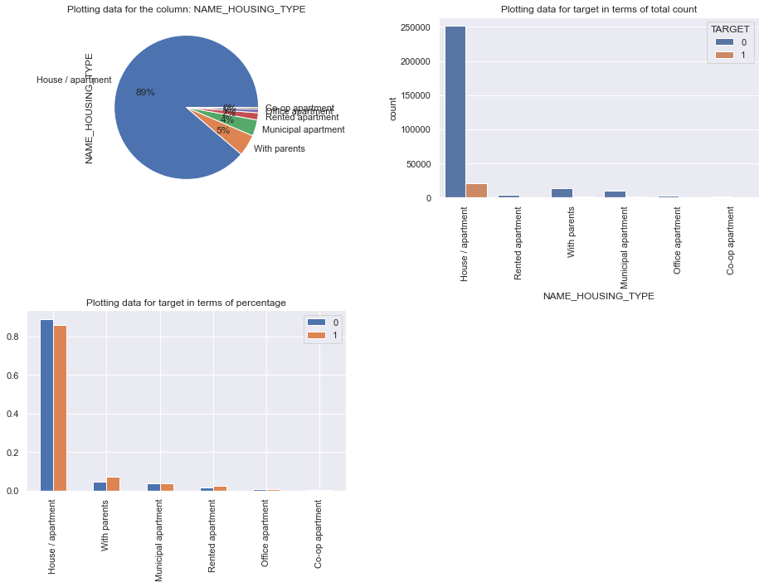
NAME_HOUSING_TYPE: Majority of people live in House/apartment People living in office apartments have lowest default rate People living with parents and living in rented apartments have higher chances of defaulting.

Slide 16
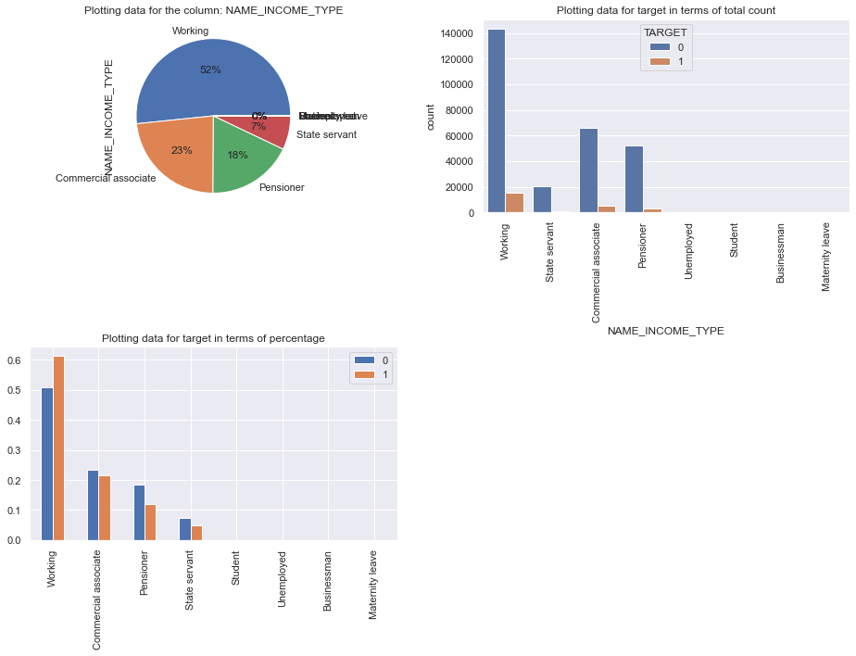
NAME_INCOME_TYPE: Pensioner and state servant defaulter is lower. Working and Commercial associate have higher default rate Student and Businessmen though less in numbers, do not have default record. Safest two categories for providing loan Most of applicants for loans income type is Working, followed by Commercial associate, Pensioner and State servant.

Slide 17
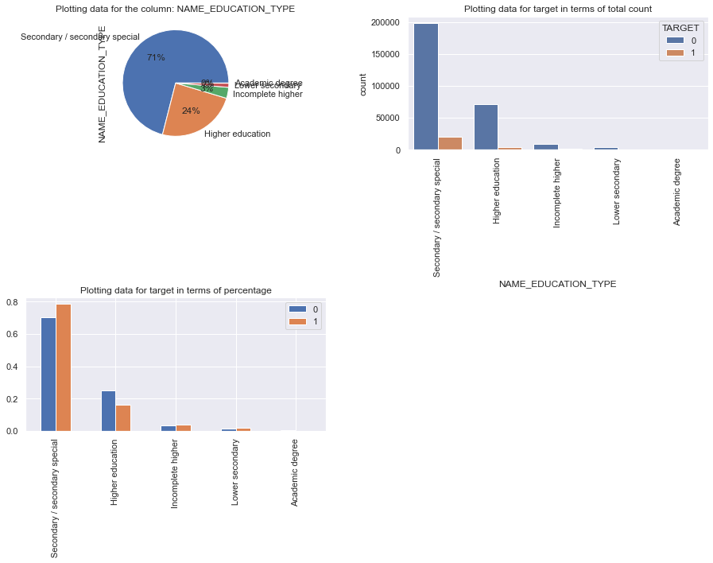
NAME_EDUCATION_TYPE: Most client take loan for secondary education followed by higher education. But the default rate in secondary education is much high and for higher education is much low.

Slide 18
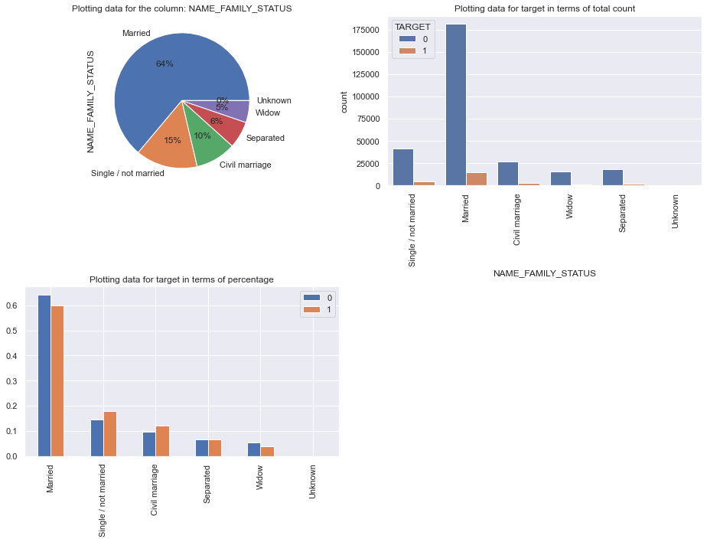
NAME_FAMILY_STATUS: Most married people apply for loan, and mostly they are not defaulters. Single and civil marriage have higher default rate.

Slide 19
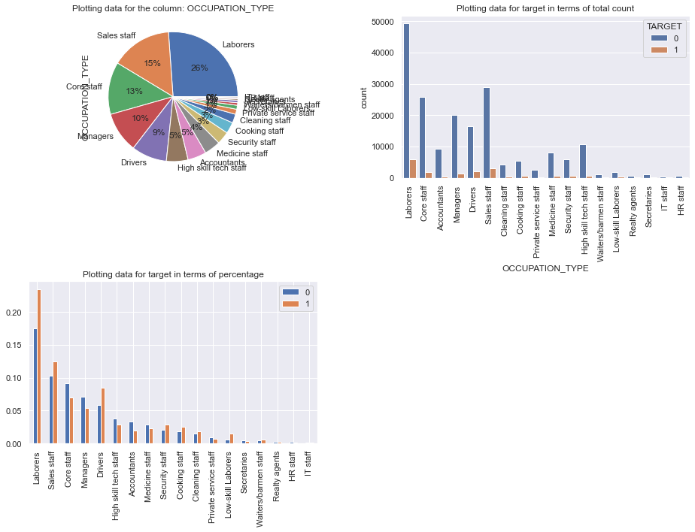
OCCUPATION_TYPE: Laborers and different categories of staffs mostly taken the loan, but the managers and the high skilled tech staffs are most relaible. Category with highest percent of defautess are Low-skill Laborers followed by Drivers and Waiters/barmen staff, Security staff, Laborers and Cooking staff IT staff are less likely to apply for Loan.

Slide 20
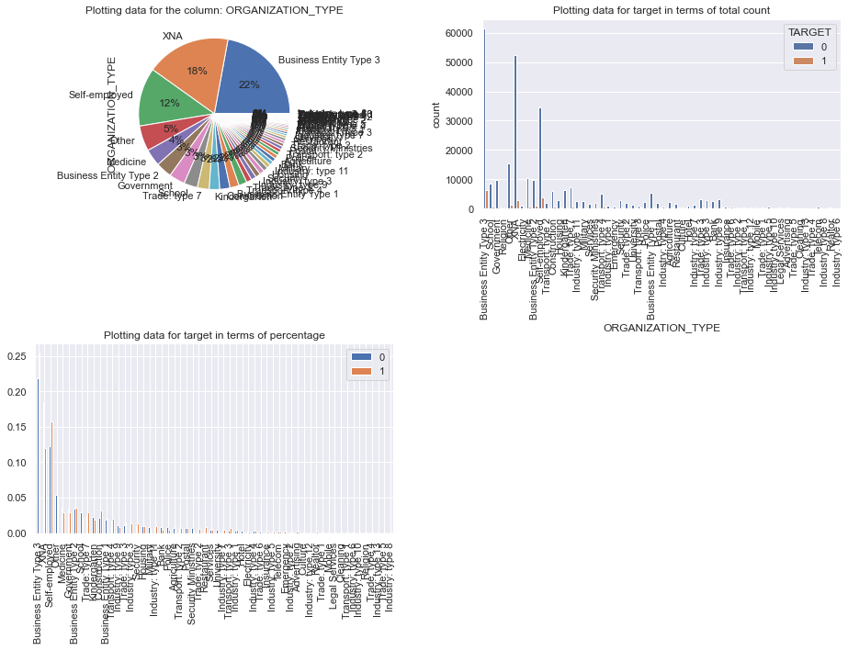
ORGANIZATION_TYPE: Self employed people have relative high defaulting rate as compare to others.

Slide 21
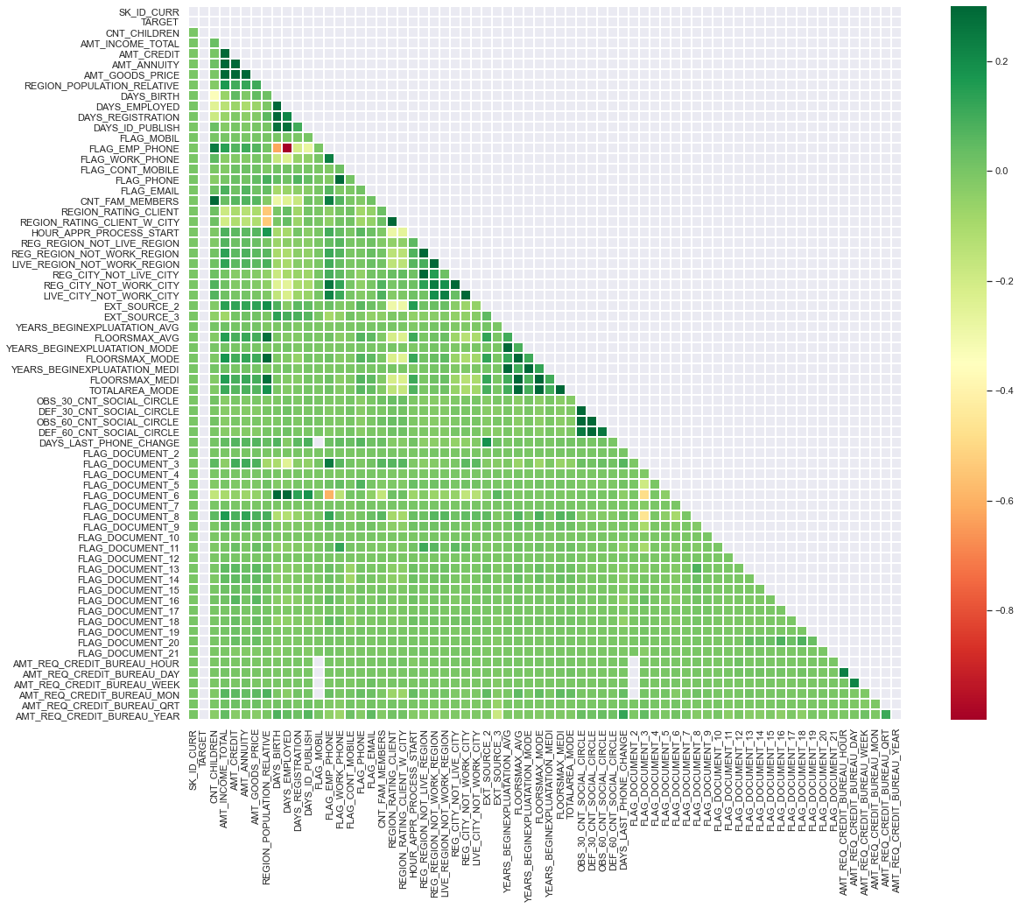
Univariate Analysis of Numerical columns
NON -DEFAULTER

Slide 22
Insights:
1.Credit amount is highly correlated with:
Goods Price Amount
Loan Annuity
Total Income
2.We can also see that repayors have high correlation in number of days employed.
Finding the top 10 correlation :
DAYS_EMPLOYED FLAG_EMP_PHONE 0.999758
OBS_60_CNT_SOCIAL_CIRCLE OBS_30_CNT_SOCIAL_CIRCLE 0.998510
FLOORSMAX_AVG FLOORSMAX_MEDI 0.997253
YEARS_BEGINEXPLUATATION_MEDI YEARS_BEGINEXPLUATATION_AVG 0.993582
FLOORSMAX_MODE FLOORSMAX_MEDI 0.988153
AMT_CREDIT AMT_GOODS_PRICE 0.987022
FLOORSMAX_MODE FLOORSMAX_AVG 0.985603
YEARS_BEGINEXPLUATATION_AVG YEARS_BEGINEXPLUATATION_MODE 0.971032
YEARS_BEGINEXPLUATATION_MEDI YEARS_BEGINEXPLUATATION_MODE 0.962064
REGION_RATING_CLIENT REGION_RATING_CLIENT_W_CITY 0.950149

Slide 23
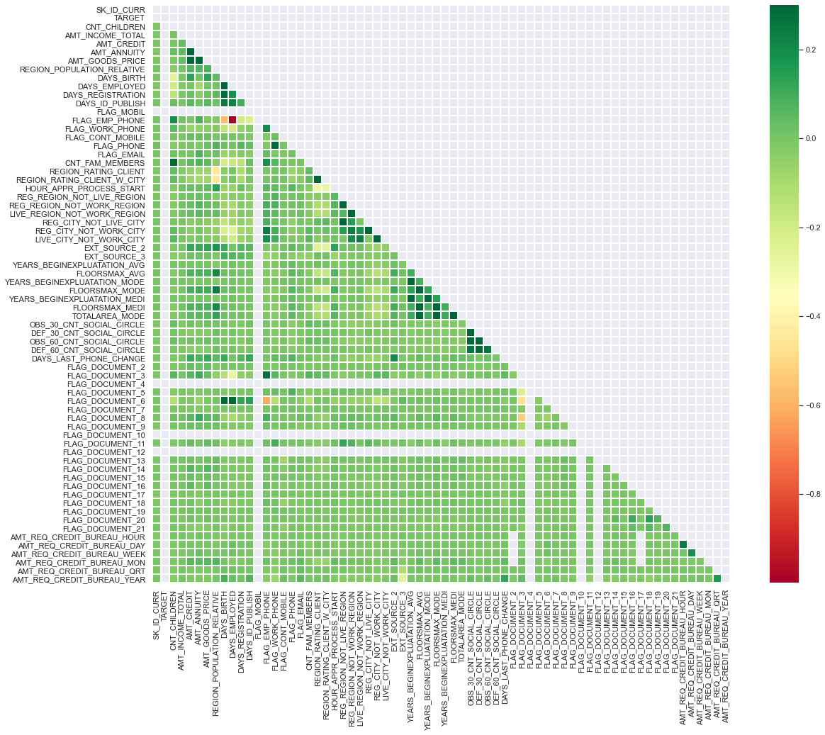
Defaulter

Slide 24
Insights :
Credit amount is highly correlated with good price amount which is same as repayors.
Loan annuity correlation with credit amount has slightly reduced in defaulters when compared to repayors.
We can also see that repayors have high correlation in number of days employed when compared to defaulters.
Finding the top 10 correlation :
DAYS_EMPLOYED FLAG_EMP_PHONE 0.999702
OBS_60_CNT_SOCIAL_CIRCLE OBS_30_CNT_SOCIAL_CIRCLE 0.998270
FLOORSMAX_MEDI FLOORSMAX_AVG 0.997295
YEARS_BEGINEXPLUATATION_MEDI YEARS_BEGINEXPLUATATION_AVG 0.996124
FLOORSMAX_MODE FLOORSMAX_MEDI 0.989195
FLOORSMAX_MODE FLOORSMAX_AVG 0.986594
AMT_GOODS_PRICE AMT_CREDIT 0.982783
YEARS_BEGINEXPLUATATION_AVG YEARS_BEGINEXPLUATATION_MODE 0.980466
YEARS_BEGINEXPLUATATION_MODE YEARS_BEGINEXPLUATATION_MEDI 0.978073
REGION_RATING_CLIENT_W_CITY REGION_RATING_CLIENT 0.956637

Slide 25
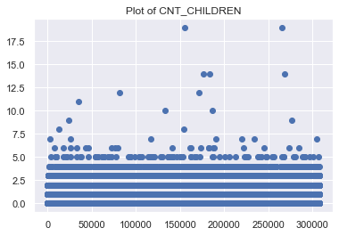
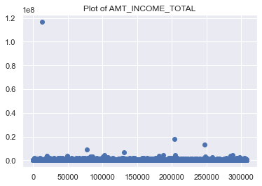
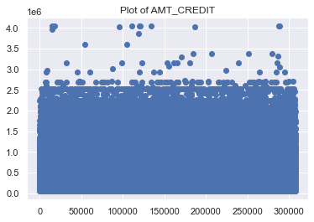
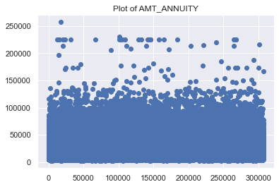
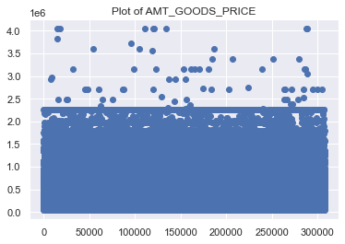
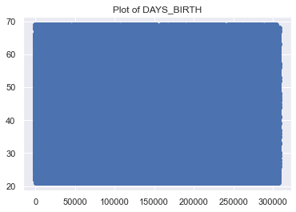
Analysis for the outliers

Slide 26
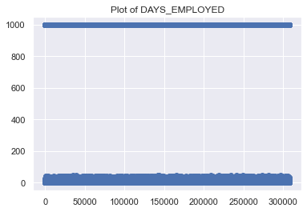
Insight:
It can be seen that in current application data AMT_ANNUITY, AMT_CREDIT, AMT_GOODS_PRICE,CNT_CHILDREN have some number of outliers.
AMT_INCOME_TOTAL has huge number of outliers which indicate that few of the loan applicants have high income when compared to the others.
DAYS_BIRTH has no outliers which means the data available is reliable.
DAYS_EMPLOYED has outlier values around 350000(days) which is around 958 years which is impossible and hence this is incorrect entry.

Slide 27
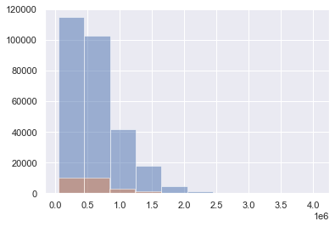
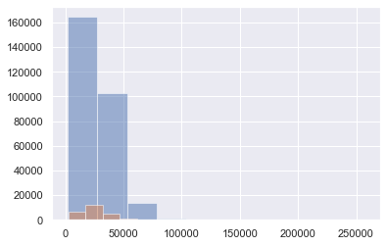
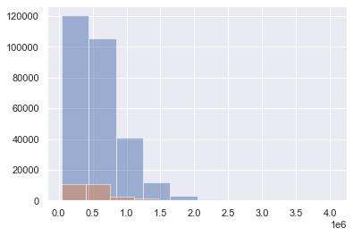
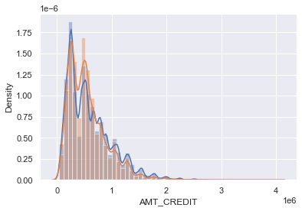
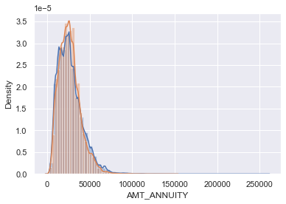
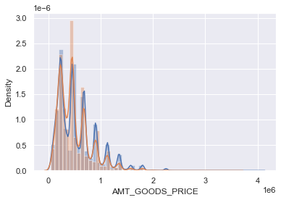
Univariate Analysis for numerical data

Slide 28
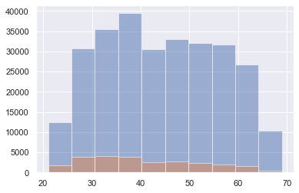
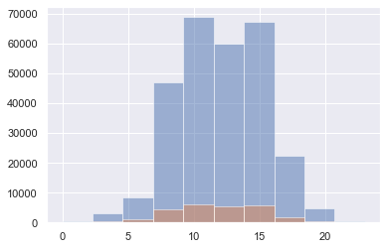
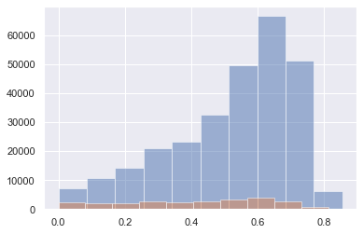
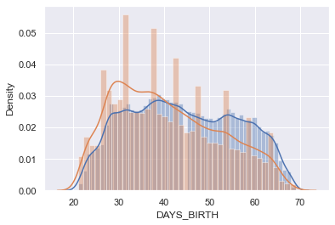
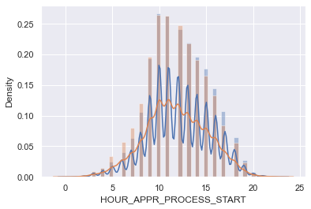
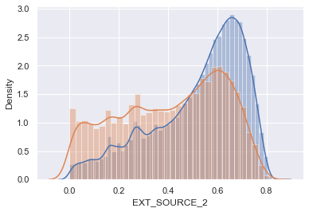
Insights:
Most no. of loans are given for goods price below 10 lakhs
Most people pay annuity below 50K for the credit loan
Credit amount of the loan is mostly less then 10 lakhs
The columns which seems different where both the histogram and distribution plot are different for the target = 0 and target = 1 are: AMT_CREDIT, HOURS_APPR_PROCESS_START, EXT_SOUCE_2, EXT_SOURCE_3, AMT_ANNUITY, AMT_GOODS_PRICE, DAYS_BIRTH, AMT_REQ_CREDIT_BUREAU_YEAR.

Slide 29
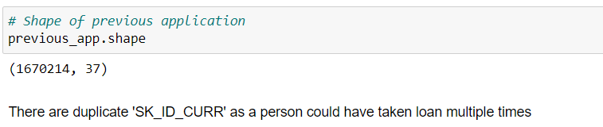
Reading previous application
Insights :
As we find in above details, the shape of previous application is (1670214, 37) and length of SK_ID_PREV is also (1670214), but length of SK_ID_CURR is (338857), which is less than length of SK_ID_PREV, so there are duplicate number of SK_ID_PREV.
Segregating the dataset on Target=0 and Target=1
Bivariate Analysis

Slide 30
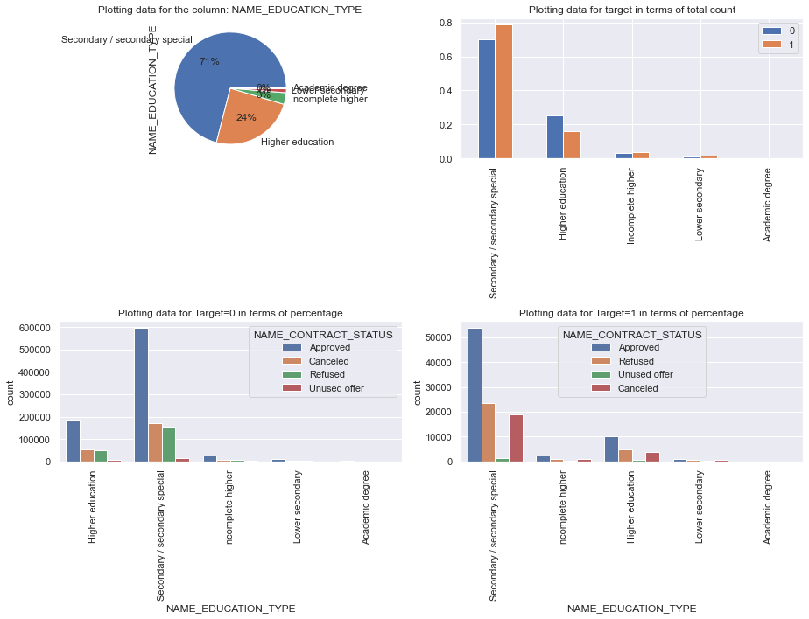
Insight : People tend to make more loan for 'Secondary special' and their loan is also approved.

Slide 31
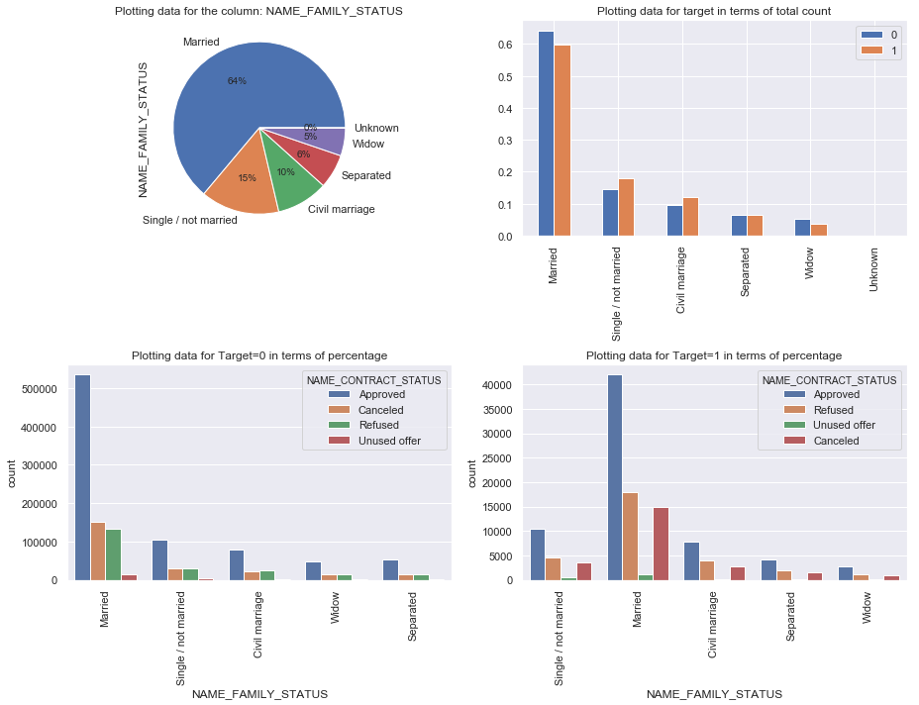
Insight : You can see, there is a clear difference for the categories for "Approved, Refused, Unused and Cancelled" for the category: Married. Married people tends to pay loan on time than Singles.

Slide 32
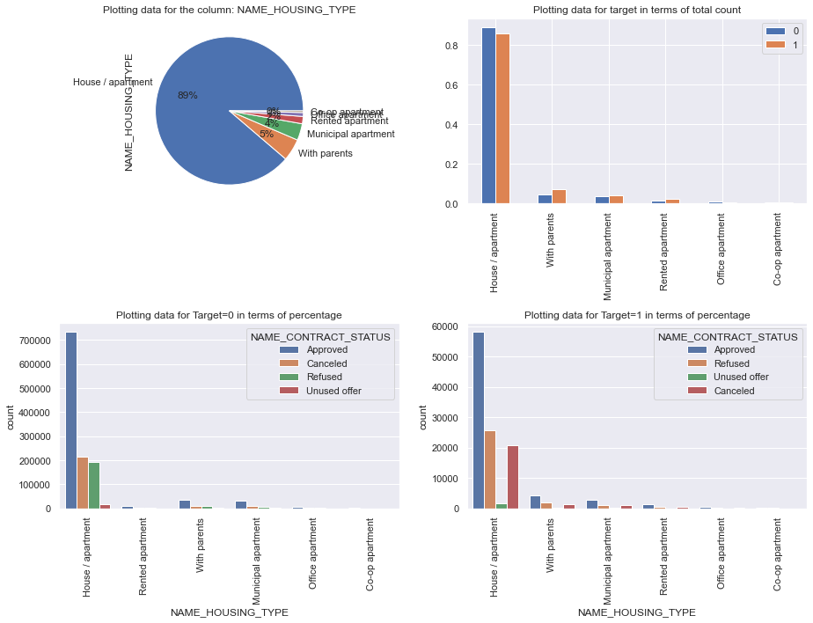
Insight : You can see, there is a clear difference for the categories for "Approved, Refused, Unused and Cancelled" for the category: House/apartment.

Slide 33
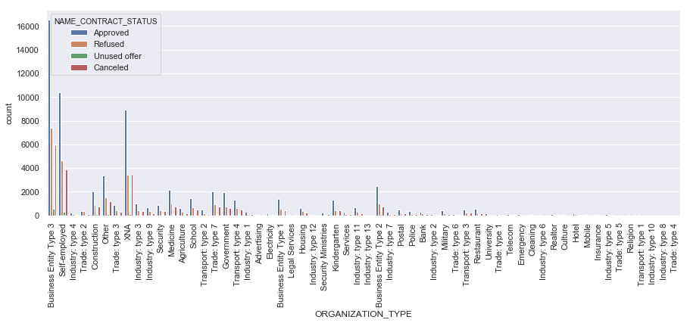
Insight: This columns seems to be most important. Business Entity Type 3 and Self-employed tends to be the maximum defaulter. The univariate analysis of this dataset was more fruitful than bivariate analysis.

